Slide 1
Project Presentation III
Kevin & David

Slide 2
Problem: Losing existing customer base

Slide 3
Current Situations
Unutilized and unorganized database
Unclear customer compositions
In-active product activity

Slide 4
Data Preparation
Feature Engineering
Clustering
Analysis
Product Recommendation

Slide 5
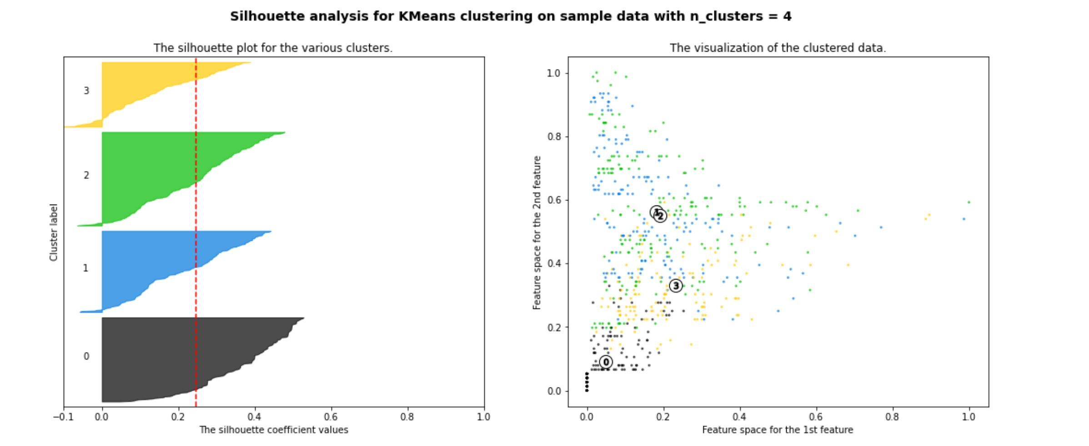
Silhouette

Slide 6
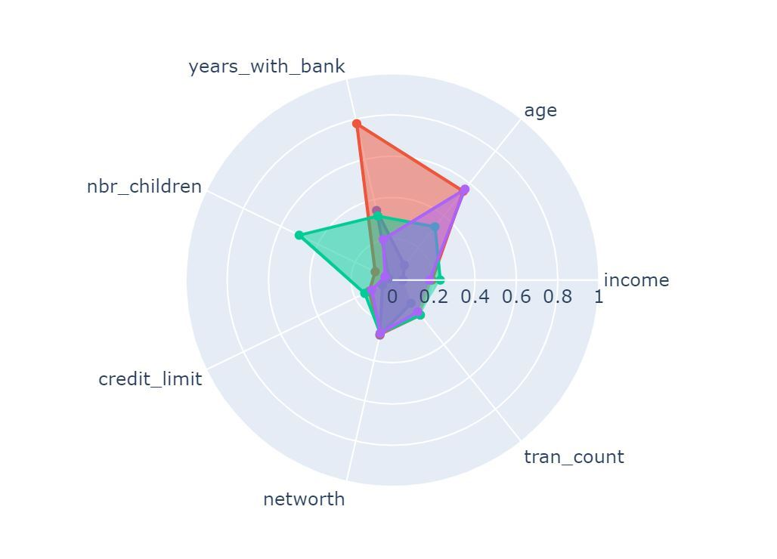
Customer Compositions
Small purple:174 (26%)
Large purple:192 (28%)
Green: 133 (20%)
Orange: 166 (25%)
75% clients don’t stay longer than 2 years
25% clients stay 7 years on average
Total: 665

Slide 7
Product Recommendations
Programs to support child care
Programs to support for pension
Programs to support educations

Slide 8
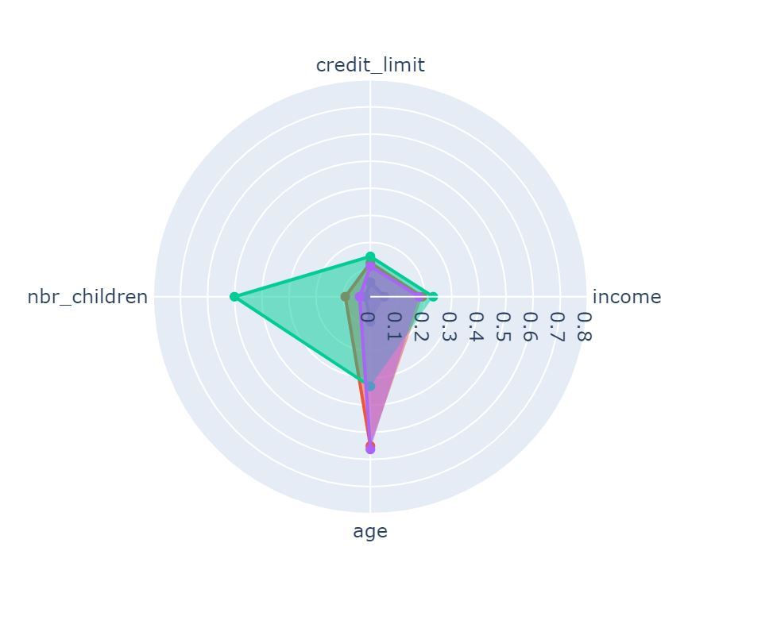
Customer Compositions

Slide 9
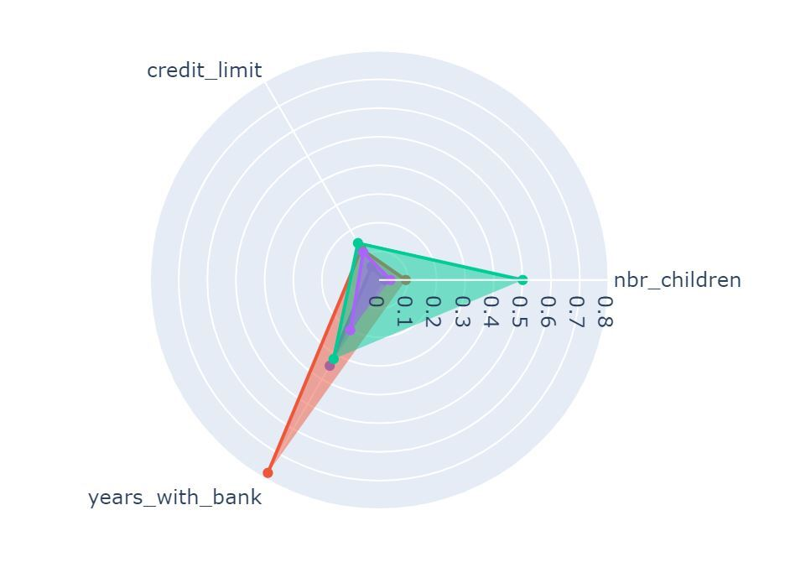
Customer Compositions

